Slide 1

Workshop
2020

Slide 2
Welcome!

Slide 3
Disclaimer
All workshop presentations, SIG/WG sessions will be recorded and made available publicly afterwards.

Slide 4
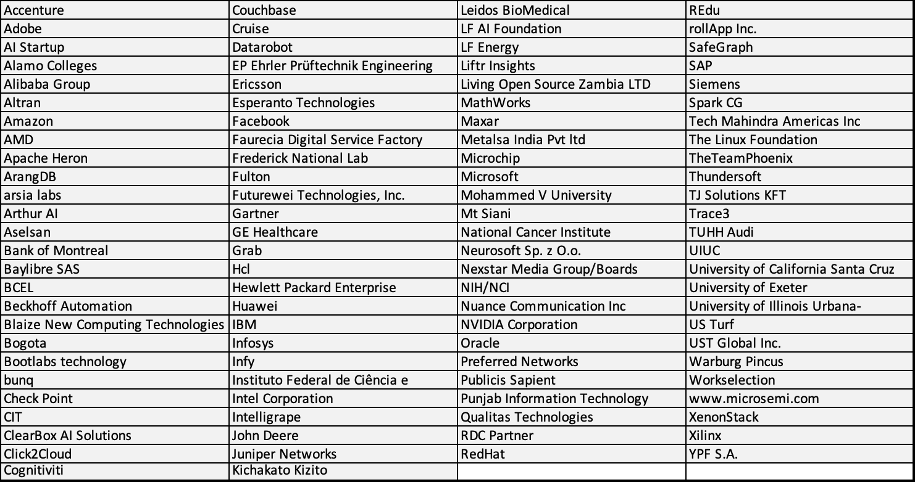
Here today … 200+ registrants, 100+ organizations

Slide 5
Logistics
Host of Zoom Meeting will share the slides on screen and record all presentations.
All participants will be muted except when presenting.
Questions should be posted in the “chat” box and will be answered during the Q&A section after each block of presentations.
Please “raise hand” (Zoom feature) if you would like to speak and engage in the discussion.

Slide 6
Goals for the Workshop
Get the latest updates on ONNX - Releases, Governance and SIGs/WGs
Learn from the community and how ONNX is being used
Share feedback on what is working (and what isn’t)
Learn how to get more involved with ONNX Steering Committee, SIGs and Working Groups

Slide 7
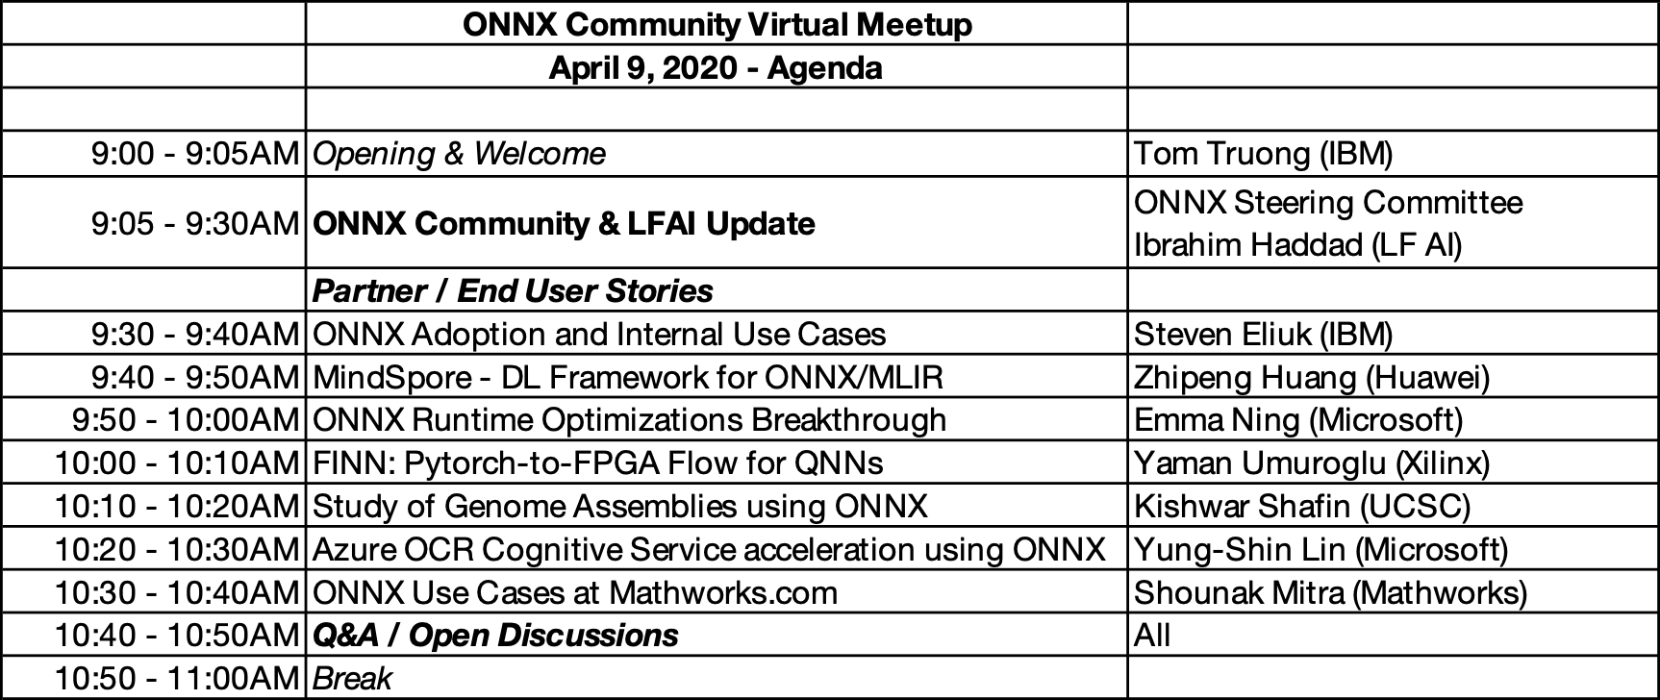
Agenda - Part 1

Slide 8
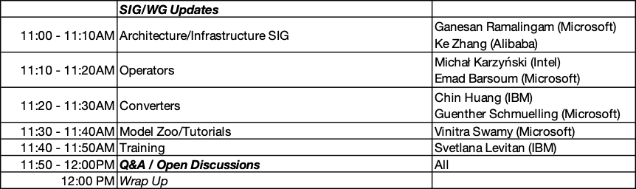
Agenda - Part 2

Slide 9
State of the state

Slide 10
Engagement & usage (compared to 3/22/19)
11%
21%
22%
1505
Pull requests
155
Contributors
8.1k
Github stars
31%
111%
24%
1.4k
Github forks
127
Published Papers
31
Models in Zoo

Slide 11







































Support
NEW
Creation/
Manipulation
LibSVM
NEW
Run/
Compile
NNOIR
Visualization/ Test Tools

Slide 12
Coming soon: ONNX 1.7
ONNX v1.7 comes with exciting new and enhanced features!
Model training, introduced as a tech preview, expands ONNX beyond original inference capabilities.
A new protobuf message is added to describe training information, including the training algorithm, initializers, and new operators such as gradients, loss functions and optimizers.
The new spec allows one to create a training model in one framework, export it in ONNX, and load into a runtime or another framework where the training can proceed.
Operator registration APIs are updated to support dynamic function body (sub-graph) registration.
Functions’ body graph are extended to be able to rely on multiple external operator sets.
The model checker is enhanced in shape inference and type constraints specified in the operator schema.
Version numbers: IR = 7, opset = 12, opset-ml = 2, opset-training = 1
Thank you everyone for your countless hours of work!

Slide 13
Governance

Slide 14
ONNX open governance recap
Steering Committee defines the vision, goals, and governance process of the ONNX community. Steering Committee is elected.
Special Interest Groups (SIGs) are persistent groups that are responsible for specific parts of the project, including ongoing maintenance of the code in their areas. SIGs are chartered by the Steering Committee.
SIGs and WGs have open and transparent proceedings.
Anyone is welcome to participate and contribute provided they follow the Code of Conduct.
Working Groups (WGs) are temporary groups formed to address issues that cross SIG boundaries. Working groups do not own any code ownership or other long term artifacts. Working groups are chartered by the Steering Committee.

Slide 15
ONNX open governance update
Steering Committee
https://github.com/onnx/steering-committee
Prasanth Pulavarthi (MS)
Joe Spisak (FB)
Vin Sharma (AWS)
Harry Kim (Intel)
Dilip Sequeira (Nvidia)
Special Interest Groups (SIGs)
https://github.com/onnx/sigs
Architecture & Infra: Lu Fang, Ke Zhang
Operators: Michał Karzyński, Emad Barsoum
Converters: Chin Huang, Guenther Schmuelling
Model Zoo & Tutorials: Vinitra Swamy
Working Groups (WGs)
https://github.com/onnx/working-groups
Training: Svetlana Levitan
Recently closed WGs: Edge/Mobile, Data Pipelines

Slide 16
ONNX open governance changes
Legal entity - LF AI is setting up a legal entity for ONNX. Charter is based on existing open governance plan.
Updated licensing - Project licensing is moving to Apache-2 (from MIT). Reclassification of prior contributions is under discussion.
CLA -> DCO - DCO is an attestation made by the contributor (versus a signed CLA) via the -s signoff (can be automated at contribution).

Slide 17
ONNX open governance election process
Now accepting applications until 4/20 (Mon): onnx.ai/sc-apply
Eligibility
Candidate: Self-nominated and not required to be a Contributor
Voter: Contributors to ONNX project
Methodology
1 vote per Member Company.
Condorcet voting with Schultz method (Ranked preference)
Contributor votes roll up to associated company
Final result based on Member Company votes
All votes published for transparency
Timeline
April: Nomination and candidate campaigns
May: Election and transition
June: New Steering Committee

Slide 18
Questions?

Slide 19
Wrap up!

Slide 20
Thank you ...
Recording of today’s workshop and other applicable content will be shared via ONNX-Announce mailing list when available.
Please stay engaged and continue to contribute to ONNX and ONNX related projects.
Remember to use the following ONNX resources:
Website: https://onnx.ai/
GitHub: https://github.com/onnx
Gitter: https://gitter.com/onnx
Calendar: https://onnx.ai/calendar
Mailing List: https://lists.lfai.foundation/g/onnx-announce

